Slide 1
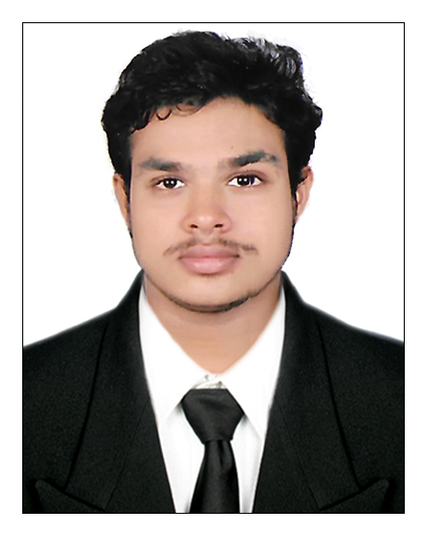
Basil Baby
Previous Experience (Prior to LTI Mindtree)
Program Analyst
Jaldee soft pvt ltd | Feb 2019 to Feb 2021
Designs and creates REST API to company requirements. Manage payment gateway and video API Modifies code to fix errors. Implemented google map Direction, Distance, Road and places API. Implemented razor-pay and PayUMoney payment gateway. Worked in singleton and object pool design pattern. Working with GitLab and GitHub based repositories, Working in Java 8 and MySQL Server
Software Engineer - ||
UST Global | April 2021 to May 2022.
Mainly my current position was a client facing role. Working with client, based on their requirements. Need to complete the screens that refer from client based on our sprint time. Develop code based on lucid chart diagram, that getting from architect. When we are working on project enhancements, Deploy project by using Argo-cd. Working with Kafka server. Quick learning and understanding different enterprise applications. Experience in writing JUnit test cases. Working with Bit-bucket repositories Working in MySQL Server and MongoDB.
LTIMindtree Experience Summary
Senior Engineer
LTIM | May 2022
Worked in VMWare client project. Getting client requirements as a JIRA user story. Following agile methodology, Need to take full responsibility of user story and complete our task based on the sprint. Working on project bug fixes and enhancements. Deploy project by using VMware cloud tool, It's already configured by DevOps team. Working with Apache Kafka server. Experience in writing JUnit and Mockito framework. Knowledge in Java 8+, Spring Boot. Experience with Maven and Grade building tools. Using MongoDB as back-end storage tool. Experience in container management tool - Kubernetes
My role: Senior Engineer “Enthusiastic software developer with four-year Experience. I have robust problem-solving skills and proven experience in creating and designing software in a test-driven development. Seeking for a job to pursue a highly rewarding career and healthy work environment where I can utilize my skills and knowledge efficiently for the organizational growth.”
Education
Mahatma Gandhi University – MCA (Master of Computer Application)
Experience
Four years of experience in Java 8 and Spring Boot Development
Designs and creates REST API based on requirements.
Working with Bit-bucket repositories.
Working in MySQL Server and MongoDB.
Implementing Third-party API to Our Applications
Six months experience in implementing Kafka
Certifications:
Google Cloud - Associate Cloud Engineer Certification (In progress)

